Slide 1


Fundamental Concepts of Data Security
Unit Outline &
General Administrative Information
1
Notes:
1

Slide 2
Acknowledgement
“I acknowledge the Wadjuk Noongar people as the traditional custodians of the land on which the Bentley campus is located, and would like to pay respect to elders past, present and emerging.”
2

Slide 3
Contact Detail
Dr. Qian Li
https://staffportal.curtin.edu.au/staff/profile/view/qian-li-24c96504/
Google Scholar
Email: qli@curtin.edu.au
Consultation: Wednesday 3:00pm-5:00pm
Email me before coming
Office: 314.347
Online Meeting https://curtin.webex.com/meet/qli
3

Slide 4
Communication
OCC (official communication channel)
Official matters – you are responsible for checking it regularly
Deferred/Further assessments
Email (please use your Curtin email)
private matters not suitable to discuss in public
write professionally and explain clearly (attachments, screenshots)
Always provide your student ID and which campus you are from
Discussion Board
General questions on data security
Not specific to you (others may wish to know too)
4

Slide 5
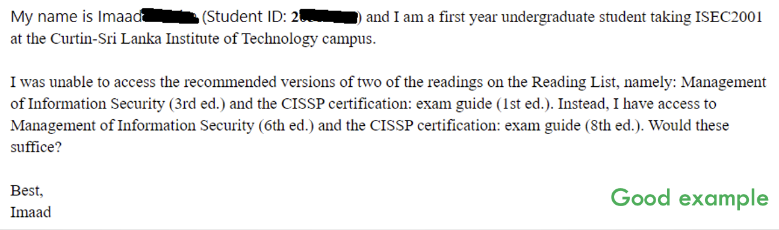
Communication
5

Slide 6
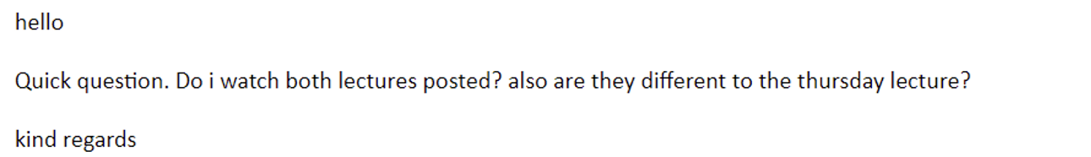
Communications
Bad example
6

Slide 7
Learning Activity
Wednesday lecture (workshop)
Combined learning activities
Tutorials (seminars)
Tutorial activity + Help
Smaller class
Teaching team: Qian,Tan
7

Slide 8
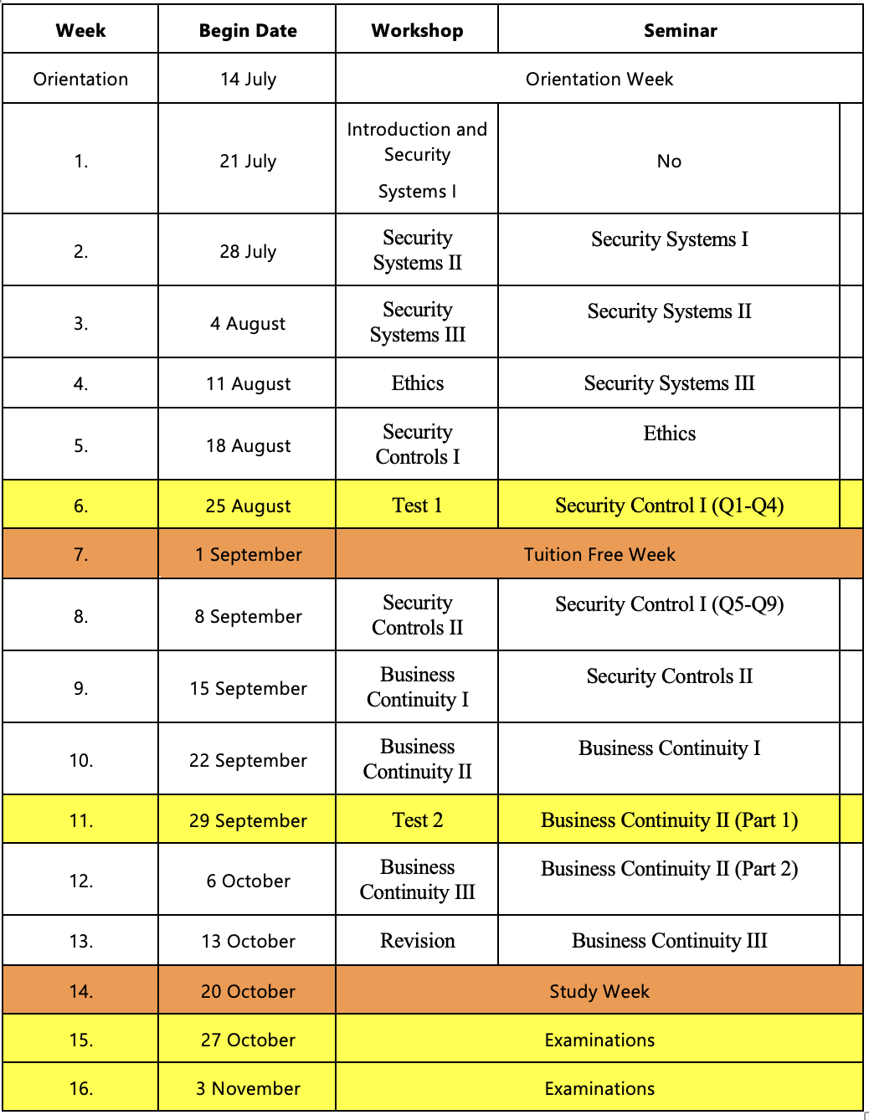
Program Calendar
8

Slide 9
Assessment Schedule
Test 1/Mid-Semester Test
Date & Time: 6:00 pm,Wednesday, 27th August (Week 6)
Venue: To be announced (possibly multiple venues)
Topics: Security Systems + Ethics
Who: ISEC2001 & ISEC5006 students
Weighting: 30% of the unit mark
Format: Open-book, hard-copy paper test
Note: Plan only,
things may change!
9

Slide 10
Assessment Schedule
Test 2 (ISEC2001 Only)
Date & Time: 6:00 pm,Wednesday, 1 Oct (Semester Week 11 / Teaching Week 10)
Venue: To be announced (possibly multiple venues)
Topics: Security Controls + BC1
Weighting: 30% of the unit mark
Format: Open-book, hard-copy paper test
Note: Plan only,
things may change!
10

Slide 11
Assessment Schedule
Assignment (only ISEC5006 students)
Due: Sunday 5-Oct -2025 (mid-day – strict deadline)
Submission: Blackboard/Turnitin
Topic: Risk assessment
Weighting: 30% of unit mark
Format: written report
NOTE: must demonstrate “reasonable attempt” to pass the unit
11

Slide 12
Assessment Schedule
Final Assessment (all students)
When: TBA
Venue: TBA
Worth: 40% of unit mark
Topics: ALL topics covered in the unit
Type: TBA
12

Slide 13
Pass Requirements
ISEC2001
Final Mark: 50% or greater; and
Final Exam: 40% or greater.
ISEC5006
Final Mark: 50% or greater; and
Final Exam: 40% or greater; and
Assignment: reasonable attempt.
13

Slide 14
Important – Assessments
It is entirely your responsibility to check announcements on Blackboard for information on scheduled assessments
Check Blackboard and email daily when it is closer to the test date
Read instructions carefully and follow them
Ask questions if not clear
All tests are open-book
Printed and hand-written materials are allowed (unlimited)
Electronic materials are NOT allowed
14

Slide 15
AE Application
Online system (access from Oasis)
https://students.connect.curtin.edu.au/app/assessment_extension
Put in an application as soon as possible (medical, employment, jury duty, family issues etc.)
Provide documentation (statutory declaration may be required)
NOTE: you should inform me in advance any anticipated problems
15

Slide 16
DA/FA
Deferred assessment
Further assessment
When: 8/12/2025 to 13/12/2025
Be available
Check your OCC regularly, especially after exams
Note: I can only recommend, I do not have the power to grant FA
16

Slide 17
Academic Integrity
All coursework students must complete AIP within 2 weeks
https://www.curtin.edu.au/students/essentials/rights/academic-integrity/aip/
Academic misconducts
Plagiarism: open-book test does not mean you can plagiarise
Collusion: I need to assess how you learn, not your classmate!
Contract cheating: confirmation check may be used if needed
Unethical/illegal use of Generative AI: next slide
Note:
Easy to pass this unit if you put in reasonable effort
All forms of cheating will be detected and dealt with
17

Slide 18
Generative AI
Check your assessment instructions carefully before using any generative artificial intelligence (Gen-AI) software (e.g. Chat GPT, Midjourney, GitHub Copilot, etc.).
You are not permitted to use Gen-AI software in any assessment task unless written permission is explicitly granted by the Unit Coordinator (e.g. within Blackboard or the assignment specifications).
If the use of Gen-AI software has been approved, you must document its use, apply appropriate acknowledgement and attribution rules, and include a statement as to the nature and extent of the use when submitting the assessment.
Unapproved, inappropriate, or undisclosed use may be dishonest or unfair behaviour, and thus considered misconduct.
For further information on the use of Gen-AI software see the Academic Integrity Website.
18

Slide 19
Generative AI
For learning, I do not have problems with you using Gen-AI tools
Just to be aware that not everything a GenAI tool produces is correct
For submissions (mainly PG assignment), I only approve Gen-AI for the purpose of proofreading your work
You must produce the work first
Obtain my written approval if other use is considered and make declaration
Also show that you have completed AIP
19

Slide 20
Learning Material
Lecture slides
Reading list (Blackboard)
Hard copies in library
Electronic
Links: guides, standards, policies, etc.
Your own research: self-learning is important
20

Slide 21
Help and Support
Ask questions
During lecture & tutorial
Discussion Board
General questions
Anonymous
Most effective
Consultation
Private matters (cannot be answered in class or on Discussion Board)
21

Slide 22
How To Study Effectively
Understand concepts well
Recall, identify, compare, analyse, evaluate
Find real-world examples
Proactively attend lecture and tutorial
Attempt quizzes, tutorial questions, mock tests and mock exam
Read provided material and outside
Ask questions
Check out Discussion Board/Discord regularly
22

Slide 23
How To Study Effectively
NOTE: many FCDS questions are open
More than one way to answer
Depending on how you construct your arguments
Be confident
Be precise: answer only what the question asks you
Be concise: avoid producing lengthy answers more than what needed to convey the main ideas
Practise and obtain feedback
23

Slide 24
Notes
The unit is being revised
Minor changes to lecture slides and tutorial worksheets
Obtain the latest version
Visit Blackboard regularly
24

Slide 25
Feedback
Important for Both of US
For you
Review any mistakes you’ve made and work on avoiding them.
Read through the feedback provided and seek clarification if anything is unclear.
For me
I’d like to know how effectively I’m teaching.
I’m also interested in what else I can do to help you learn better. Please share your thoughts promptly—don’t wait until eValuate!!
25

